Slide 1
Optimal Transport GAN
Alokendu Mazumder
PhD (1st Year), SPECTRUM Lab, Dept. of EE
IISc Bangalore
Email: alokendum@iisc.ac.in SR No: 04-03-00-10-12-21-1-20134

Slide 2
Background
The vanilla GAN architecture has issues of stability, mode collapse, intractability of loss function. And many more.
To tackle problems regarding stability and mode collapse, WGAN (Wasserstein’s GAN) was introduced, which minimizes Wasserstein distance between real data distribution and generated one. It worked well because the metric in it’s mini-batch version was tractable one.
But the gradients of the mini-batch version of sinkhorn distance were not unbiased estimators of real sinkhorn distance. Hence, Cramer’s GAN was introduced which used an energy function to compute distance between real and generated distribution.
OTGAN was proposed as the energy distance was not a valid metric over probability distribution. It used a metric called mini-batch energy distance, which is a hybrid of losses of WGAN and Cramer’s GAN. (More details are elaborated into the report)

Slide 3
Proposed Approach
OTGAN’s loss function is a valid metric over probability distribution. It’s tractable also. It is termed as mini-batch energy distance which computes the distance between real and generated distributions.
It takes best of both WGAN and Cramer’s GAN.

Slide 4

Technical Details
Generator: Takes input noise vector of size 2048. Passed via 5 transpose convolutional layers which doubles the size at every step. Final output of generator is a 64x64 image.
Discriminator: Consists of 4 convolutional layers, divides the input by factor of 2 at every step. Each Conv layer is followed by leaky ReLU activation. At last step, one L2 regularizer layer is applied.
Loss Function: Mini-Batch energy distance.
Cost Function: Cross Entropy

Slide 5
Contributions (Novelty)
The paper has used cosine similarity as cost function, I have used cross entropy.
Due to my experience in working with cosine similarity cost function, several times I have observed that it saturates too quickly in early epochs or it has a very spiky graph for training loss.

Slide 6
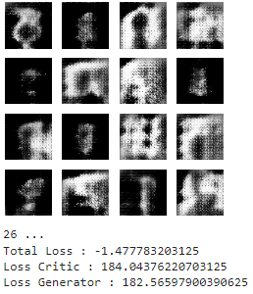
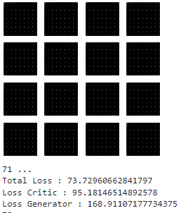
Results & Conclusion
The model is tested over MNIST handwritten digits data set with 60,000.
Adam optimizer is used with 10^(-3) learning rate.
Training is done for 7 epochs.
The results are not visually attractive because it was trained for less number of epochs due to hardware limitations. Even in baseline paper, the model (OTGAN) is trained with 8 GPU’s for several days.
Still we can see that model is trying to learn some digits.
Fig 1: Results after 5 epochs (Top) & with 2 epochs (Bottom)

